Slide 1
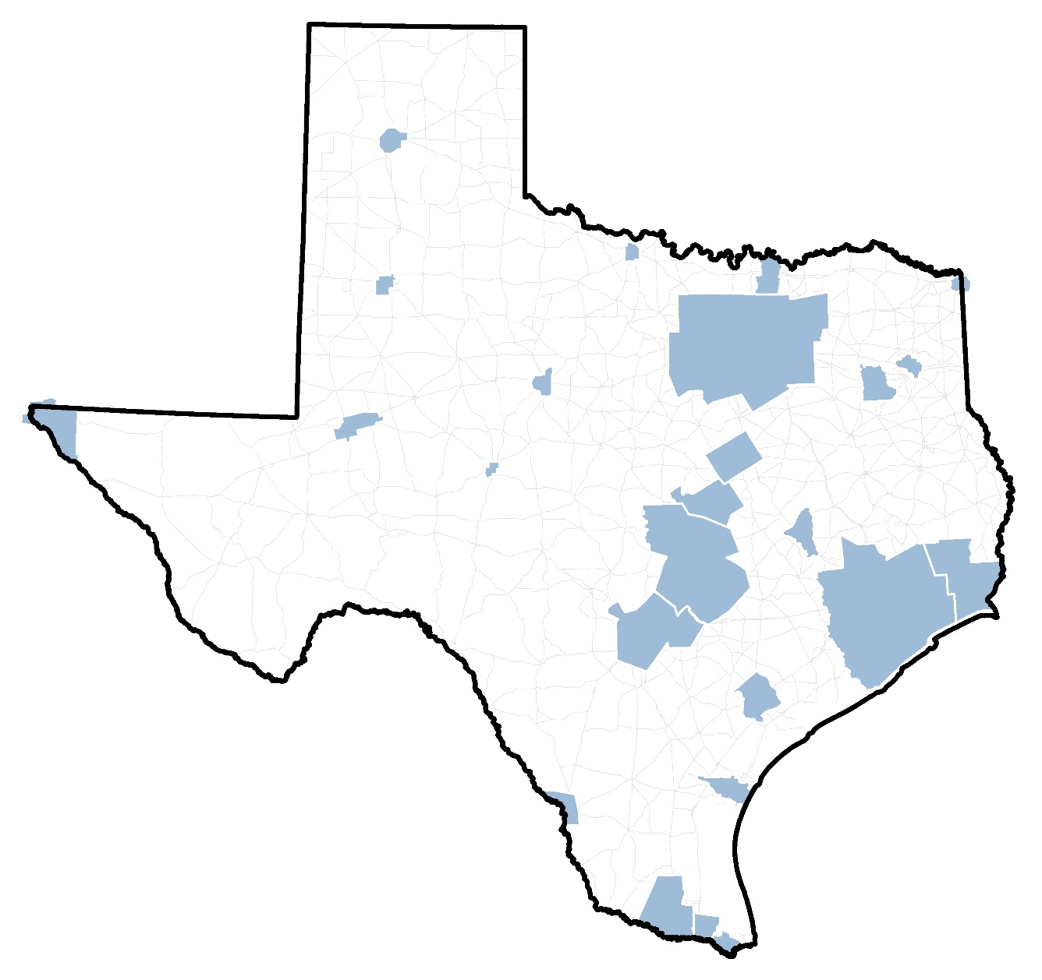
External Travel Study Process:
TxDOT Travel Survey Program
By: Michael Martin, TTI
Bill Knowles, TxDOT
Byron Chigoy, TTI

Slide 2
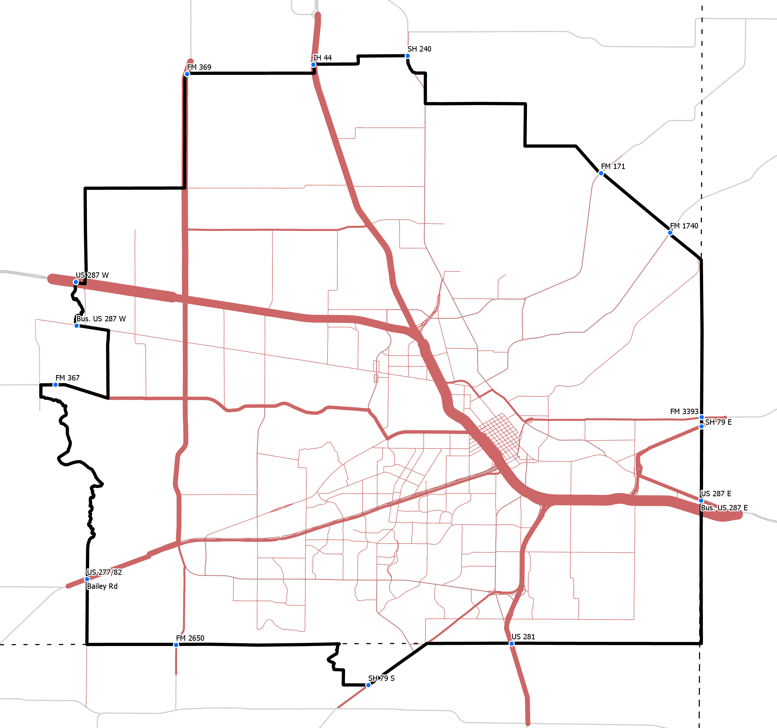
The Process
Study and geographic design
Passive data acquisition, processing, and management
Associating cellular/LBS and GPS data with roadway network
Data expansion
Reports and Dashboards

Slide 3
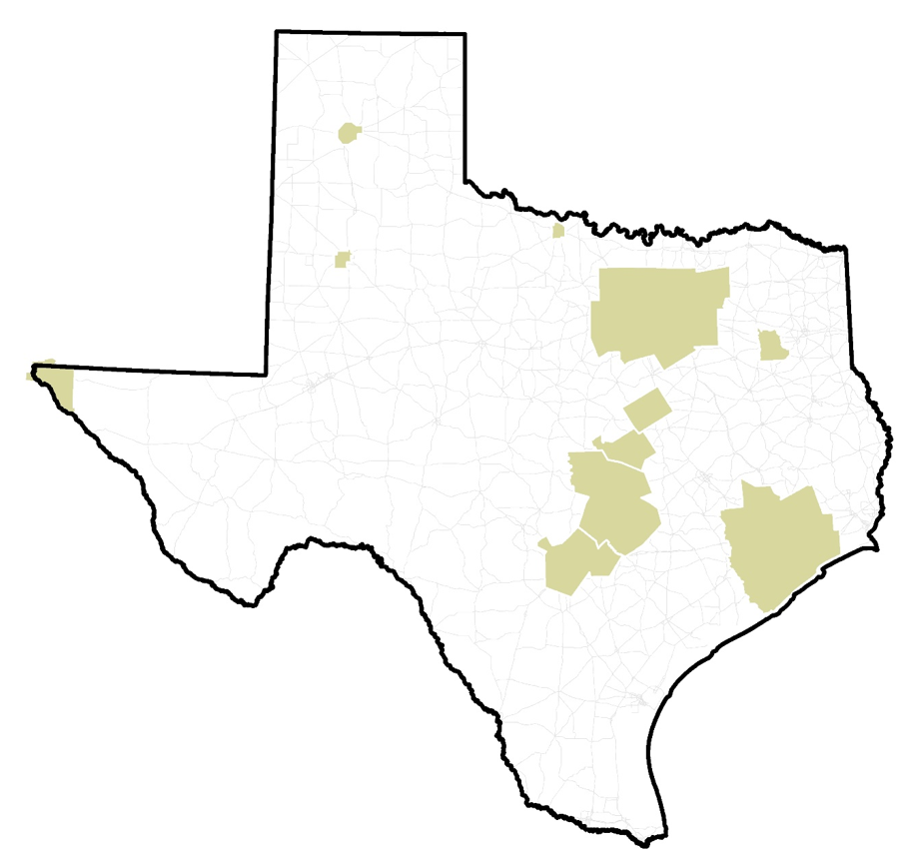
Completed /
On-Going
Studies
Amarillo
Wichita Falls
Dallas-Fort Worth
Abilene
Tyler
Waco
El Paso
Killeen-Temple
Houston-Galveston
San Antonio
Austin

